Slide 1
A PROJECT ON SNAKE GAME
AFRIDI HAQUE (20BCS3879)
SARTHAK SINGH (20BCS3861)

Slide 2

SNAKE GAME
Submitted in the partial fulfillment for the award of the degree of
BACHELOR OF ENGINEERING
IN
BIG DATA ANALYTICS
Submitted by:
AFRIDI HAQUE (20BCS3879)
SARTHAK SINGH (20BCS3861)
Under the Supervision of:
MRS. SPINDER KAUR
DEPARTMENT OF COMPUTER SCIENCE AND ENGINEERING APEX INSTITUE OF TECHNOLOGY
JULY, 2021
Department of AIT-CSE
DISCOVER . LEARN . EMPOWER

Slide 3
TABLE OF CONTENT
TOPICS SLIDE NO.
Introduction to Project ------------------------- 4
Problem Formulation ------------------------- 6
Objectives of the Work ------------------------- 7
Methodology ------------------------- 8
Result and Output ------------------------- 12
Conclusion ------------------------- 18
Future Scope ------------------------- 19
References ------------------------- 20

Slide 4
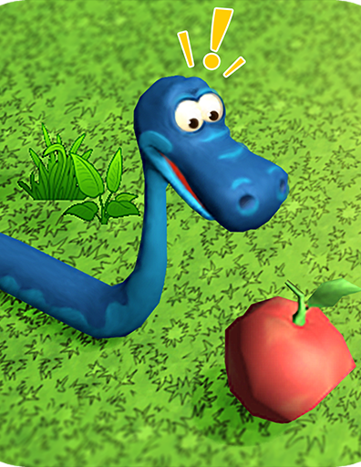
INTRODUCTION
The name of the game is “Snake Game”, it typically involve the player controlling a line or snake. We have designed this game with the help of C++ programming language. This game is one of the earliest days computer game, and has re-emerged on mobile phones in recent years.
It is one of the greatest game of the world, also it gives you an idea to build such projects with such a simple, understandable code, basically when you are a beginner.

Slide 5
INTRODUCTION (CONTD.)
So let’s talk about the gameplay, this is a single player game, involving him to control the movement of snake (line of special characters in this game) and grab all the food items appear on the console(inside the border). Each time the snake eats the foods it’s length will increase by 1 unit and also the players score will raise by 10 points.
But wait, there is a restriction too; if the snake hit the border or collide with itself, then the game will over and program will terminate. As the length of the snake increases, the game become more and more difficult.
NOKIA first implemented this game in their first generation cell phones, and it was the most popular game that time.

Slide 6
PROBLEM FORMULATION
Developing a game from scratch to discover and counter ambiguity in the path of learning is an important aspect of developmental phase.
In order to entertain and develop a clear understanding of programming language C++, we made a SNAKE GAME.
Snake Game has been a popular choice of people since the last decade when one of the known cellphone company manufactured and delivered a significant impact on locals.
This game has its own legacy but we can design and built it in a unique manner with easy-to-understand code.

Slide 7

OBJECTIVES
The objectives of this project were –
To develop the foundation of programming language C++
To gain insights about uncommon libraries and header.
Hands on operational learning through easy-to-understand implementation.
To establish a fundamental co-relation with compatible platforms.
Develop and sustain the fundamentals
We infer to make new substitute and changes by developing this game from scratch.

Slide 8
METHODOLOGY
This game named “Snake Game” is a basic, old game which we implement with the help of C++ language. The gameplay is also very easy. All the instructions has been provided on the welcoming console, under RULE. Only you have just to move the snake with the help of keyboard and eat the foods provided at different coordinates of the console. The length of the snake and player’s score will increase every time whenever the snake will eat food. The game will over when the snake head touches the border of console or bite itself.
We have used our past programming experience, learning and some other resources (mentioned in the reference part) to design this game. We encountered with new library headers like <windows.h>, which contains declarations for all of the functions in windows API, all the common macros used by windows programmer, and all the data types used by the various functions and subsystems.

Slide 9
METHODOLOGY (CONTD.)
We also use the random function to generate food at random coordinates of the console; sleep() function to set the snake and console speed; kbhit() to take input from keyboard and many more.
Basically we have used loops, logical operations and switch cases to design the game. So that it remain simple and understandable. Astonishingly it is just 180 line code (comment excluded).
Requirements :
1. Operating system : Windows
2. Platform : Dev-CPP/VS-Code
3. Language : C++

Slide 10
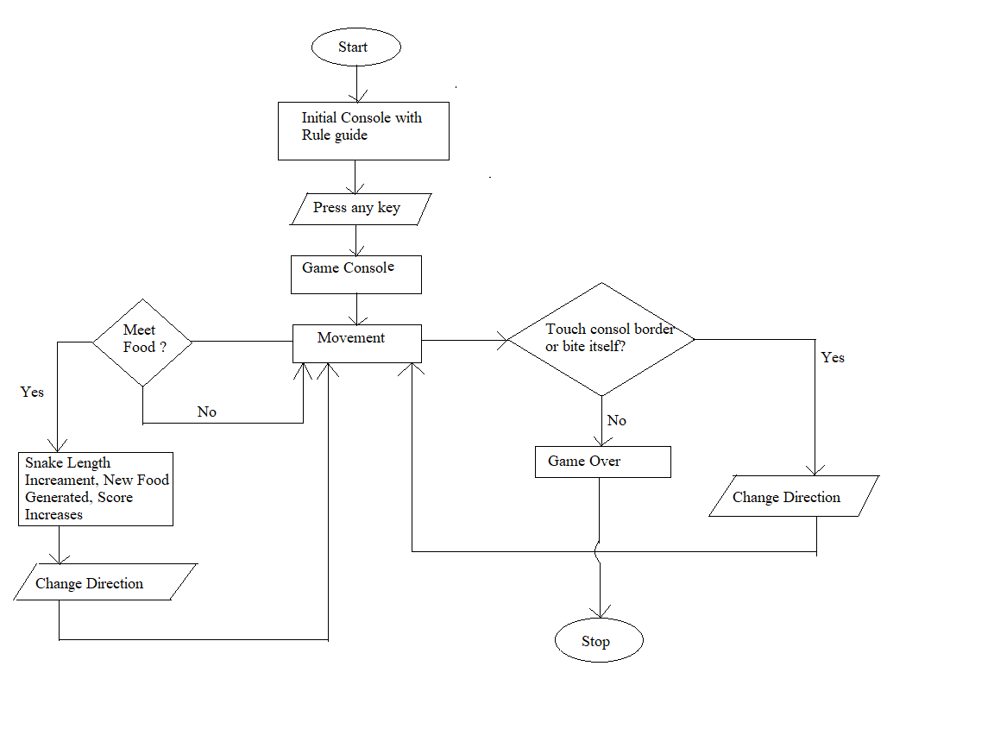
METHODOLOGY (CONTD.)

Slide 11
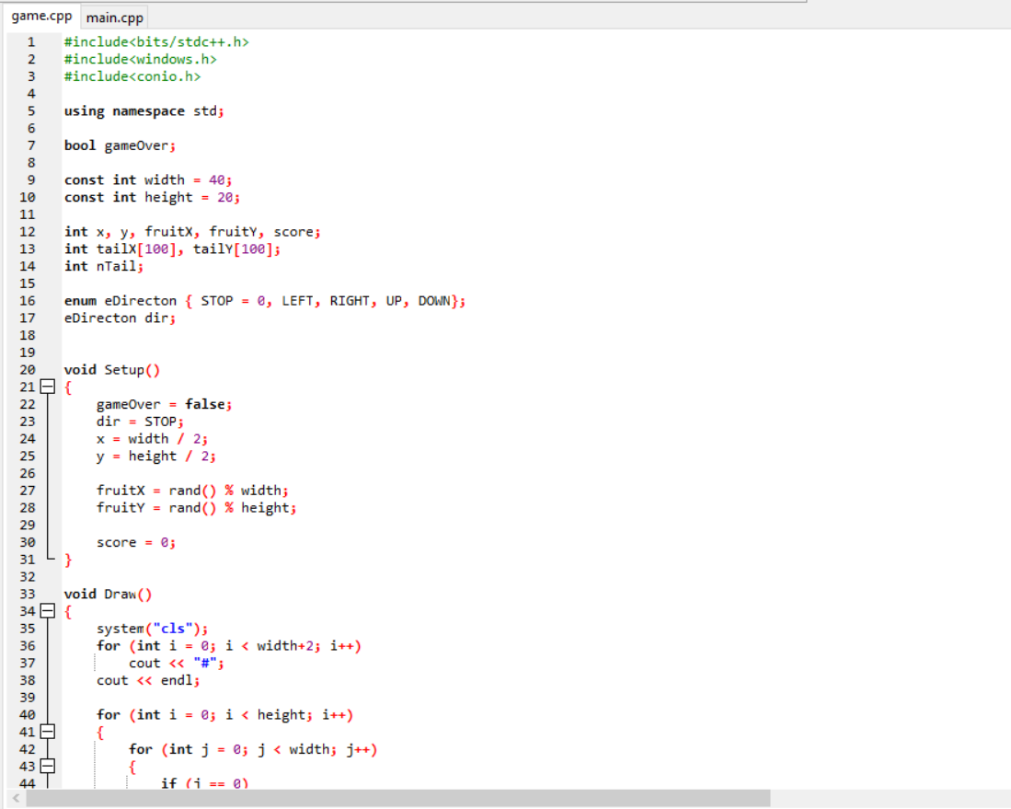
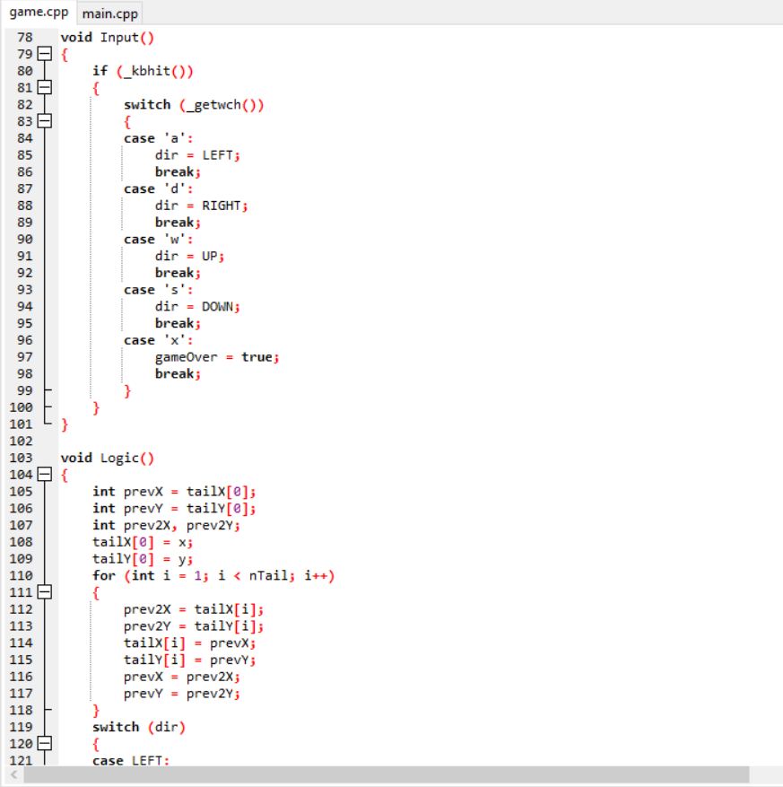
Code Snippet

Slide 12
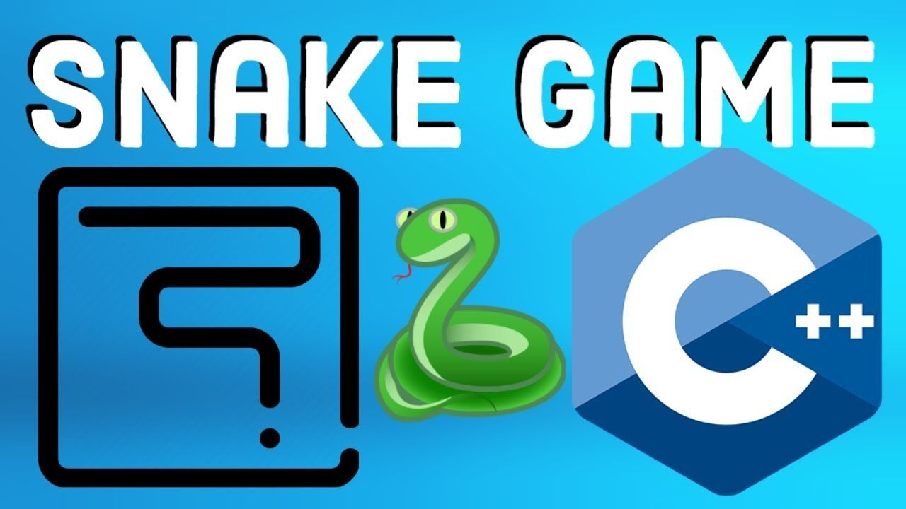
RESULT AND OUTPUT

Slide 13
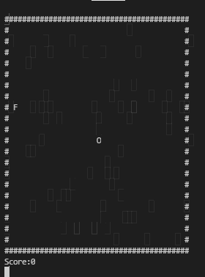
RESULT
After compiling and executing the code, a welcoming window will open which contains the Rules of the game. Then to start the game we have to press any key. Now the game console will visible blinking constantly, the initial snake will visible in the shape of ‘O’ and the food will visible in the form of ‘F’.

Slide 14
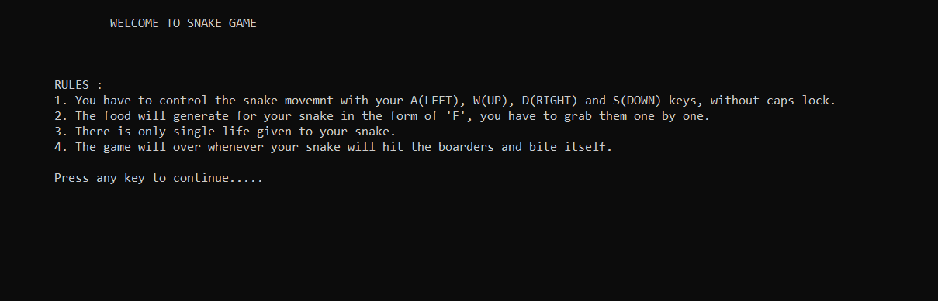
Welcome page containing rules

Slide 15
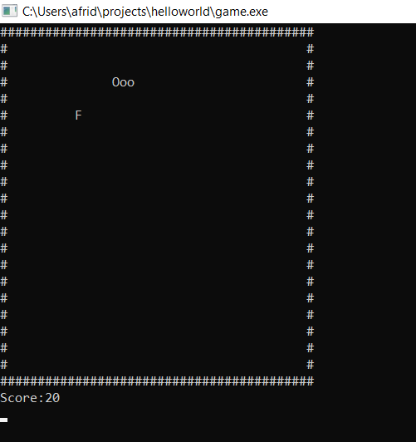

Slide 16
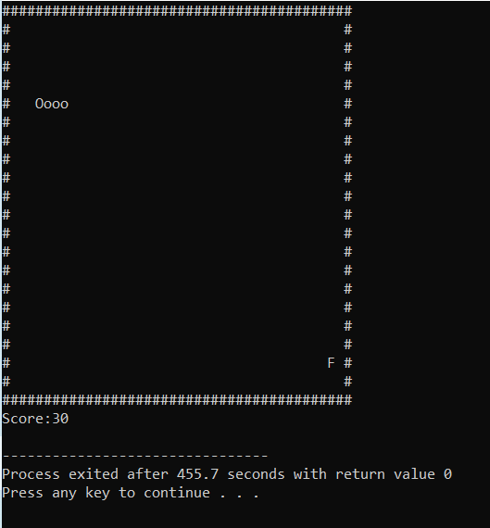

Slide 17
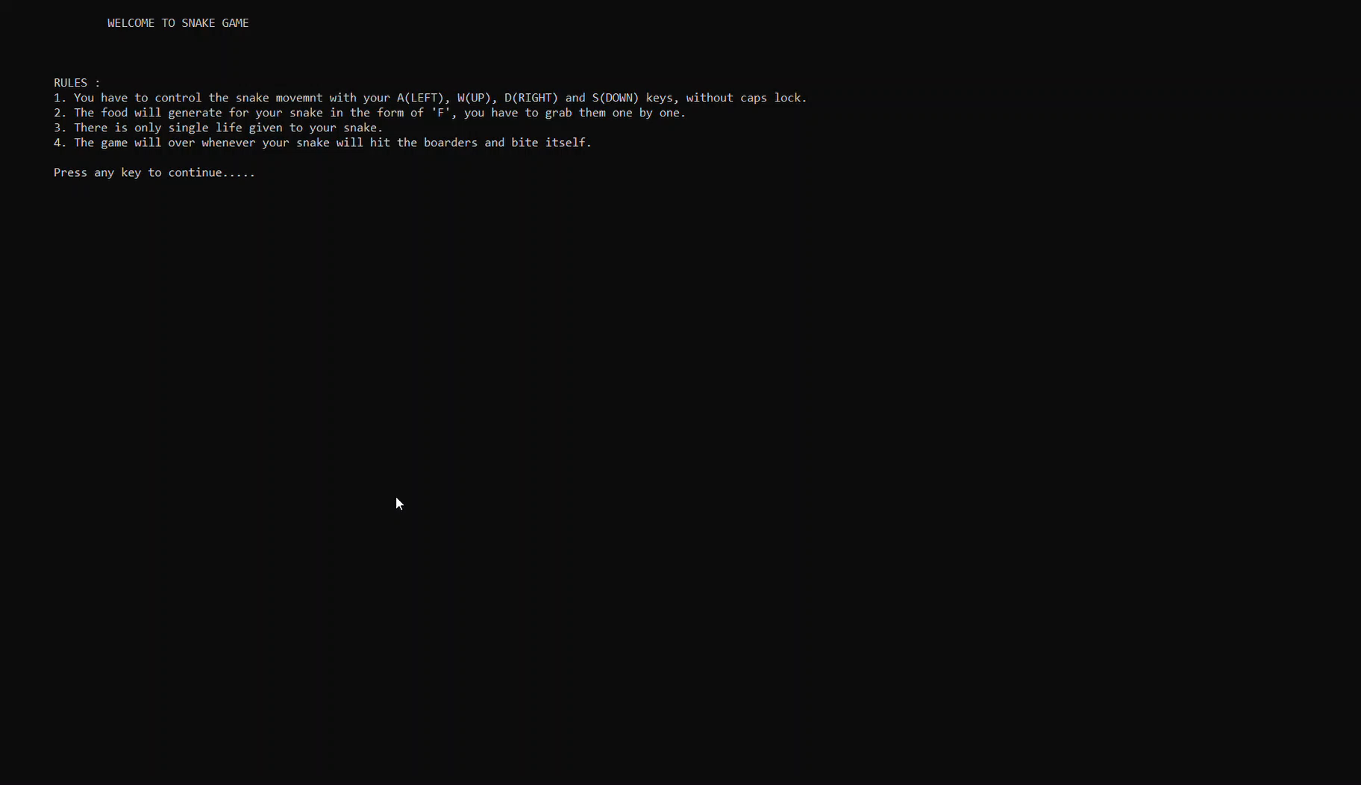
Demonstration Video

Slide 18
CONCLUSION
From previous slides you might get the whole theme and idea of how the gameplay exactly is, it is quite simple and enjoying. The speed of movement of the snake may vary from machine to machine. But it should kept at a moderate level to get the best gaming experience. This game has an executable file which is 1880 kb in size, in some updated machine it will be unplayably fast, so you need to re-compile it.
This is a beginner level game designing, which gives us the basic knowledge of C++, some exceptional functions, error handling, project build up and taught us the value of team work. We enjoyed doing this project and learned a lot.

Slide 19
FUTURE SCOPES
Our project will be able to implement in future after making some changes and modifications as we make our project just as a beginner, so it is mostly at the low level. So the modifications that can be done in our project are:
1. Graphics can be added to make it more realistic.
2. We can store the scores and name of players each time.
3. We can add one more snake to make it more competitive.

Slide 20
REFERENCES
Website Link:
https://www.javatpoint.com/snake-code-in-cpp
https://www.instructables.com/C-Snake-Game-Simple/
https://thepoorengineer.com/en/snake-cplusplus/
https://www.theprogrammingassignmenthelp.com/blog-details/c-plus-plus-programming-snake-game

Slide 21
REFERENCES
Video Link :
https://www.youtube.com/watch?v=E_-lMZDi7Uw
https://www.youtube.com/watch?v=W1e5wO7XR2w&t=328s
https://www.youtube.com/watch?v=ON5ODiA-AQE
https://www.youtube.com/watch?v=AxrQje7V65o&t=1091s
https://www.youtube.com/watch?v=KTyemy82Zqk

Slide 22
THE END
THANK YOU

